Slide 1
Epsilon AI Institute
Final Project Presentation

Slide 2

Aslm Fawzy Abd-Elkader Ahmed
Faculty of Artificial Intelligence KSU
ML Head in IEEE KSB
DS Core Member in GDSC KSU

Slide 3
Problem And Dataset

Slide 4
The dataset consists of house prices from King County an area in the US State of Washington . Dataset consisted of historic data of houses sold between May 2014 to May 2015 and contained 21 variables and 21597 observations.
Problem is Regression Problem .
More Information about dataset and problem : https://www.kaggle.com/harlfoxem/housesalesprediction

Slide 5
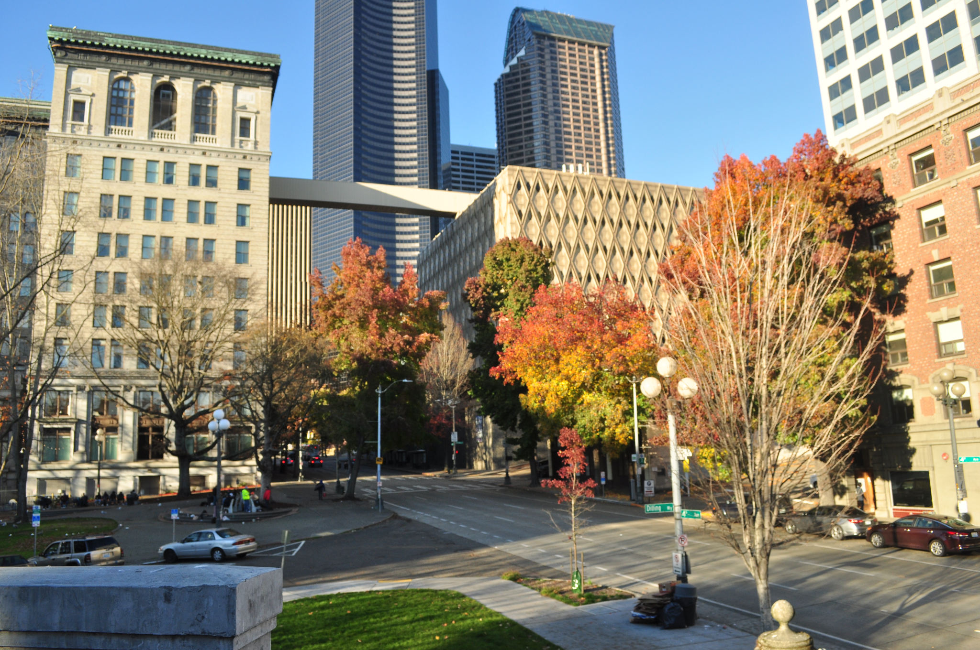

Slide 6
Brief Insights in Dataset

Slide 7
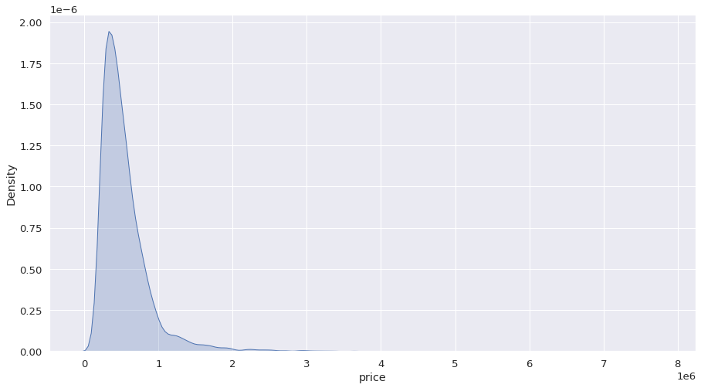
Houses Prices Distribution

Slide 8
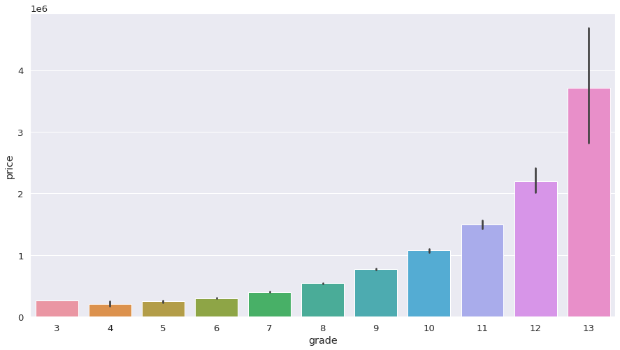
Price Average in Each Grade

Slide 9
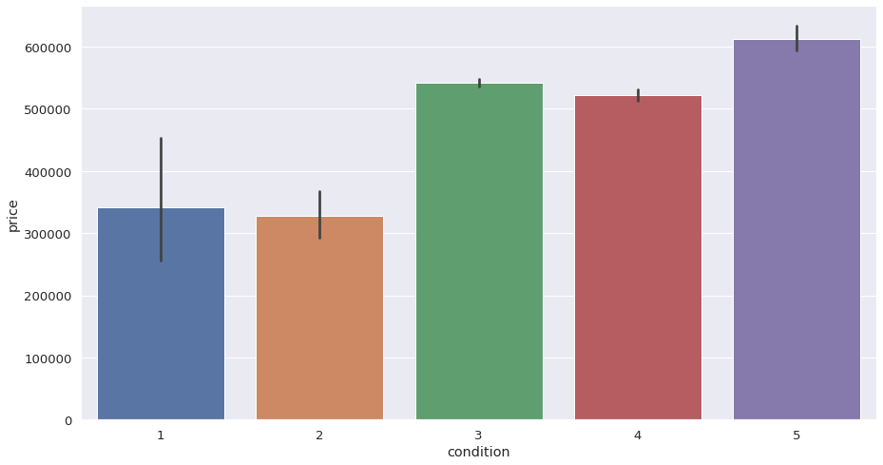
Price Average in Each Condition

Slide 10
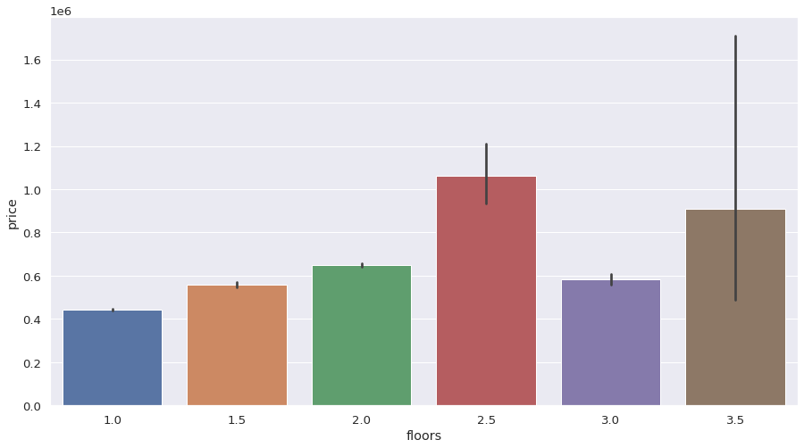
Price vs Floors

Slide 11
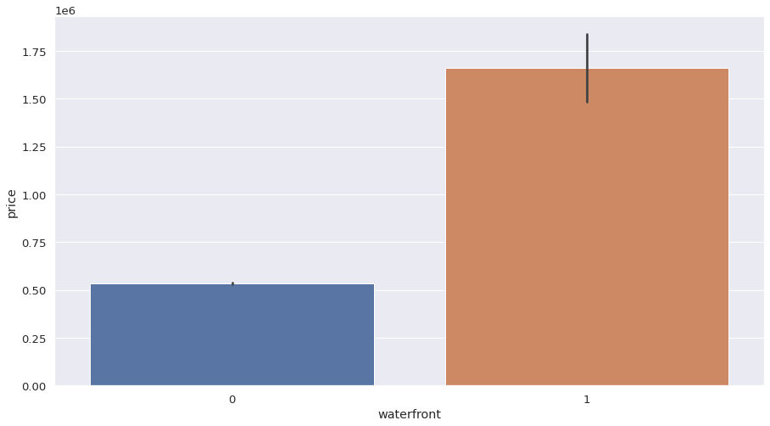
How much does house cost if it has waterfront ?

Slide 12
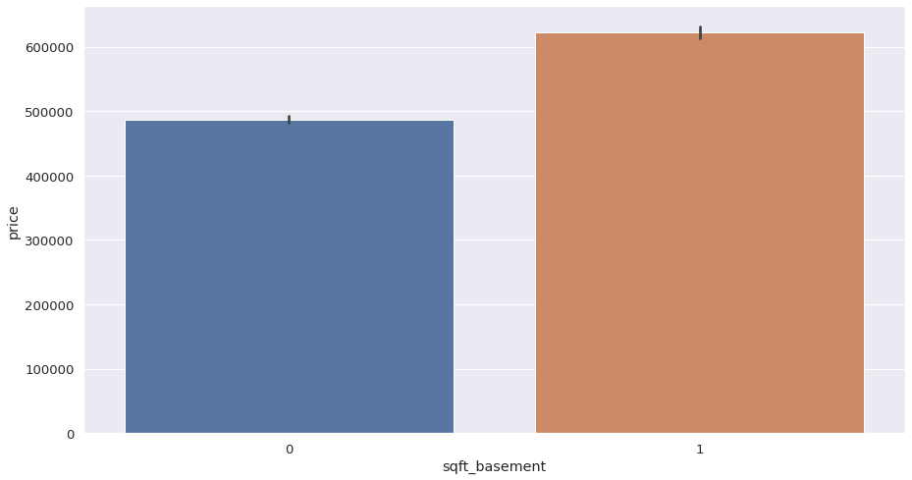
How much does house cost if it has basement ?

Slide 13
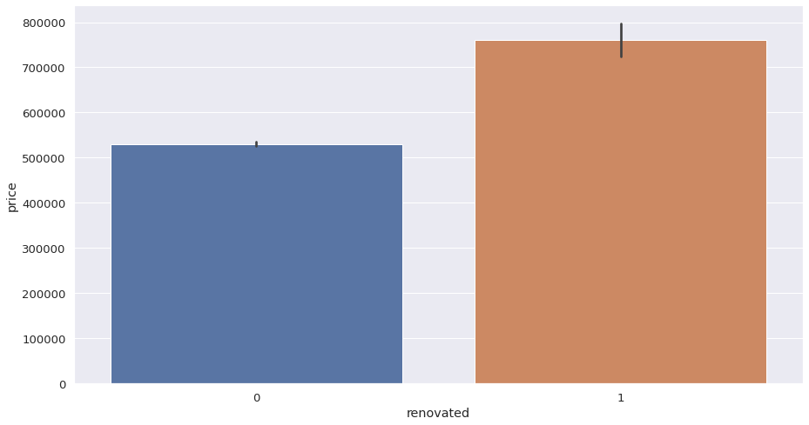
How much does house cost if it has been renovated ?

Slide 14
Machine Learning Model

Slide 15
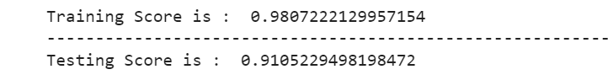
After feature engineering , data splitting and feature scaling, by using XGBoost Regressor I can reach to following accuracy :

Slide 16
HTML Template

Slide 17
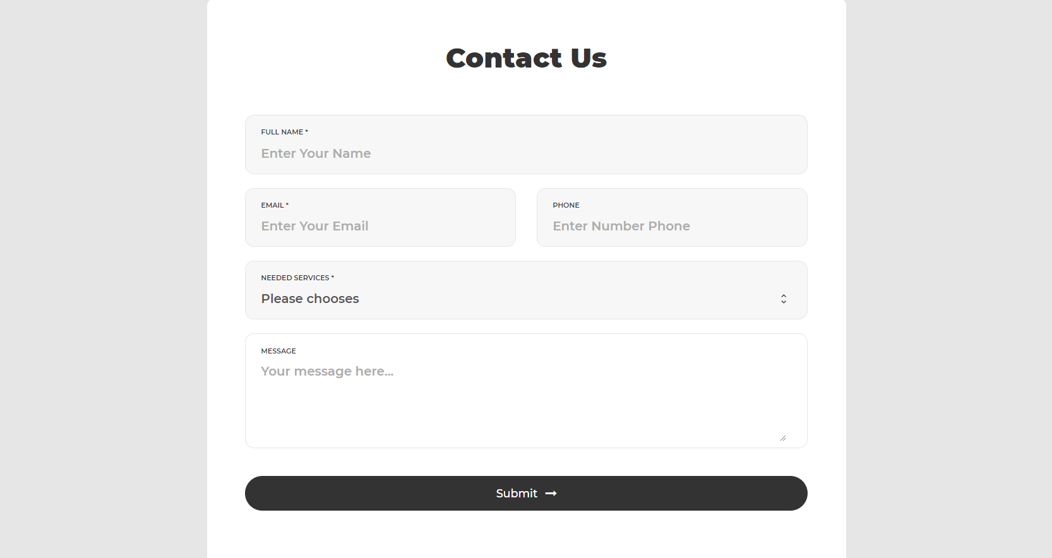
Before Editing

Slide 18
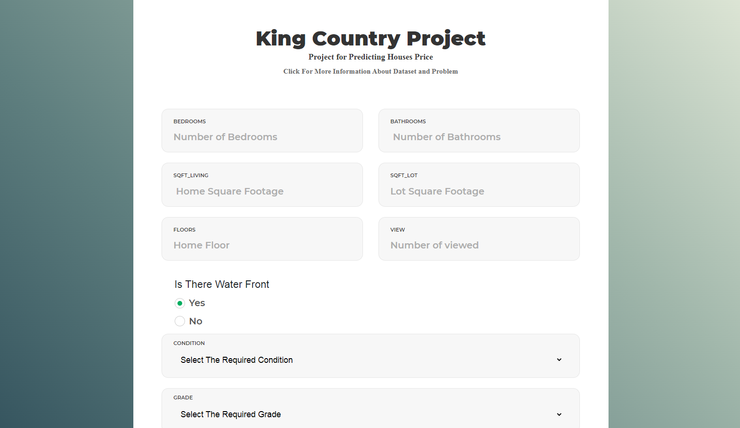
After Editing
Input Template

Slide 19
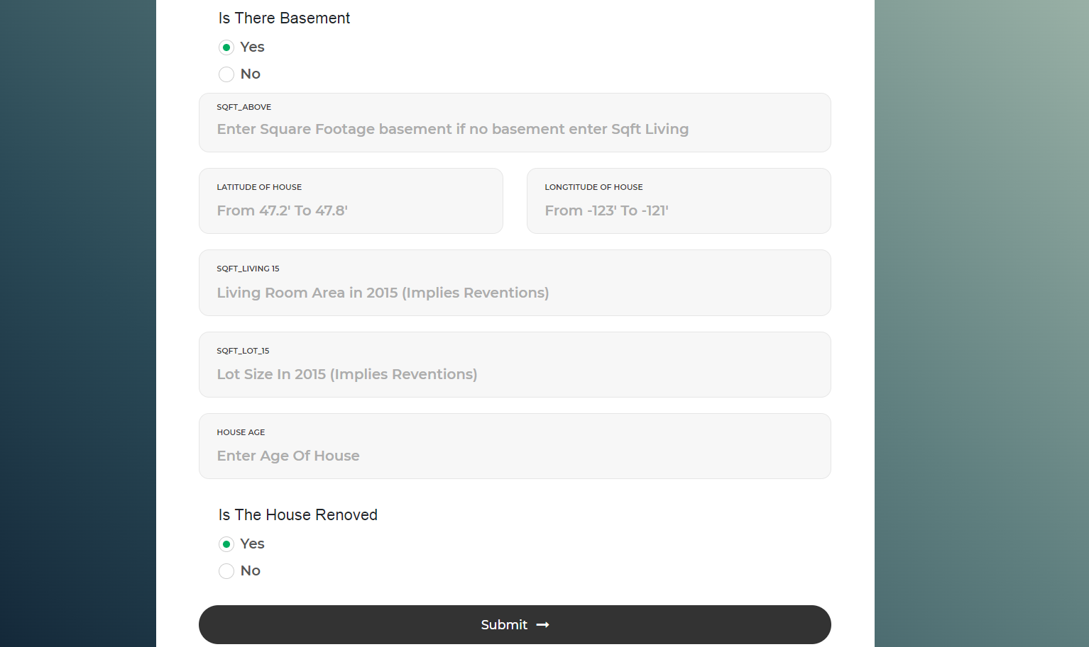
Input Template

Slide 20
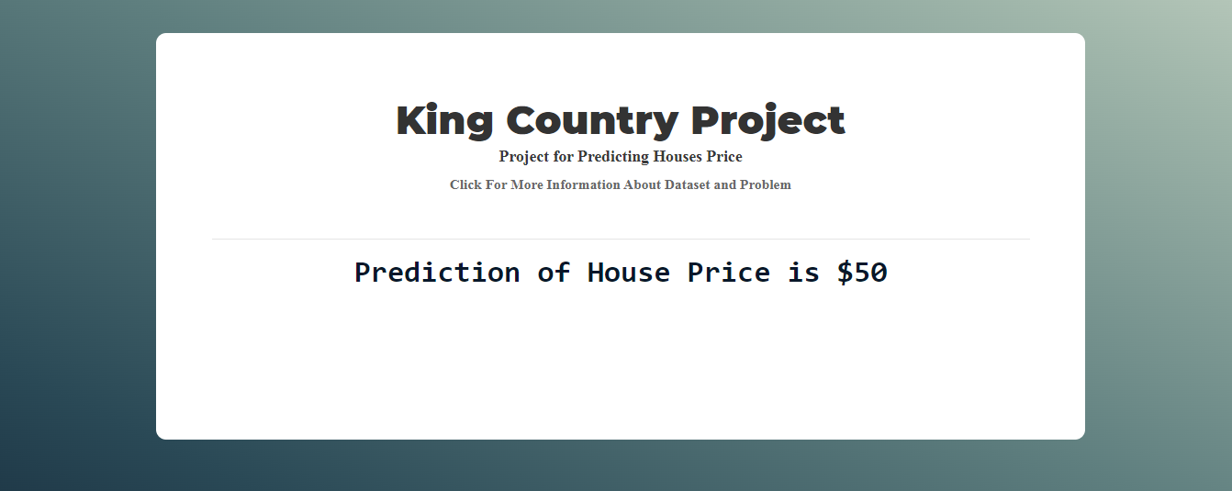
Predication Template

Slide 21
Deployment on Heroku

Slide 22
After creating web app successfully , I deploy my model in Heroku to be as website that any person can use it to predict house price in King Country in Washington in USA.
For trying the Website : https://kc-p.herokuapp.com/

Slide 23

Lets Try The Website

